Slide 1

CLAIMS FRAUD MODEL OPERATIONAL REVIEW – FINAL MODEL
October 2020

Slide 2
CONTENTS
Exhibit Intro
Modeling Approach
Fraud Model Evaluations
Database Creation and Extraction Techniques
Feature Engineering
Boostrapping
Modeling Techniques (TPOT, Pipeline, Gridsearch, Etc)
Implementation / Business Impact
Future Steps

Slide 3
EXHIBIT INTRO - EXECUTIVE SUMMARY
Regis University practicum course requested a project which applied techniques introduced throughout the degree program. Today’s conversation will review the candidate model produced.
Objectives:
Provide an overview of the modeling processes and methodologies
Review the Claims Fraud Model final model performance and prediction explanation
Discuss unique machine learning techniques used
Review applicable next steps
Highlights:
Improved method for database interaction and table creation with Pandas
The ability to explain the prediction and put it into an actionable insight
Feature Synthesis, Outlier correction, and Automated Pipeline
Feature reduction to remove unnecessary data and improve overall performance

Slide 4
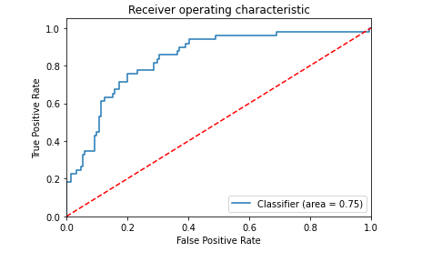
EXHIBIT INTRO – Gini (ROC AUC) Chart Building and Interpretation
Building
Line represents the % of true positive (Sensitivity) captured compared with false positive rate (100 - Specificity) at a given cut point
Interpretation
Measures the classifiers ability to distinguish the two classes
Is the area under the curve > .50?
The straight diagonal line shows a random. The closer the curve is to 45 degrees, the less predictive.
Does the curve maximize differential between random?

Slide 5
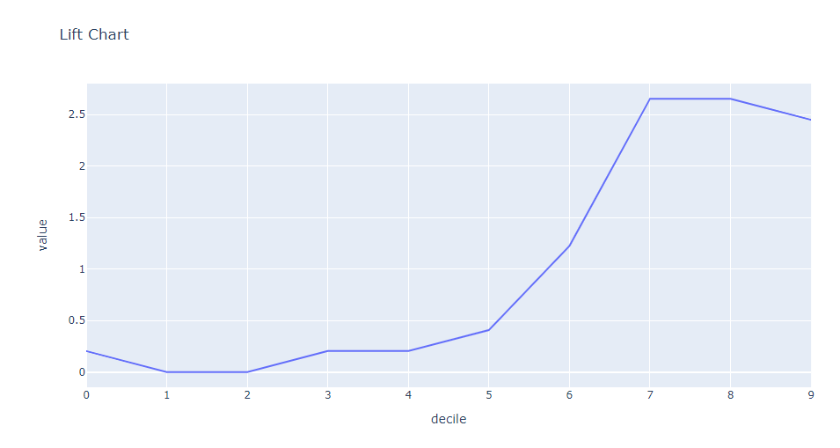
EXHIBIT INTRO – Lift Chart Building and Interpretation
Building
Sort claims from low prediction to high (probability)
Define groups by splitting into 10 equal bins
For each bin measure the average prediction
Interpretation
Predictions (line)
Is there an obvious upward trend?
Does there appear to be good separation?
Decile lift (value at each line)
Total incremental difference in predictions from each decile to prior decile

Slide 6
CONTENTS
Exhibit Intro
Modeling Approach
Fraud Model Evaluations
Database Creation and Extraction Techniques
Feature Engineering
Boostrapping
Modeling Techniques (TPOT, Pipeline, Gridsearch, Etc)
Implementation / Business Impact
Future Steps

Slide 7
MODELING APPROACH - Overview
1000 rows of data
Data split – 80% for Training, 20% for Testing
Gradient Boosting method was used in final model
Outlier removal with Gaussian Approximation
Target Encoding for categorical features
Deep Feature Synthesis using multiplicative and additive primitives
Synthetic bootstrapping used to augment data samples
Automated Pipeline for analysis assistance
Model performance evaluated using lift and auc curve

Slide 8
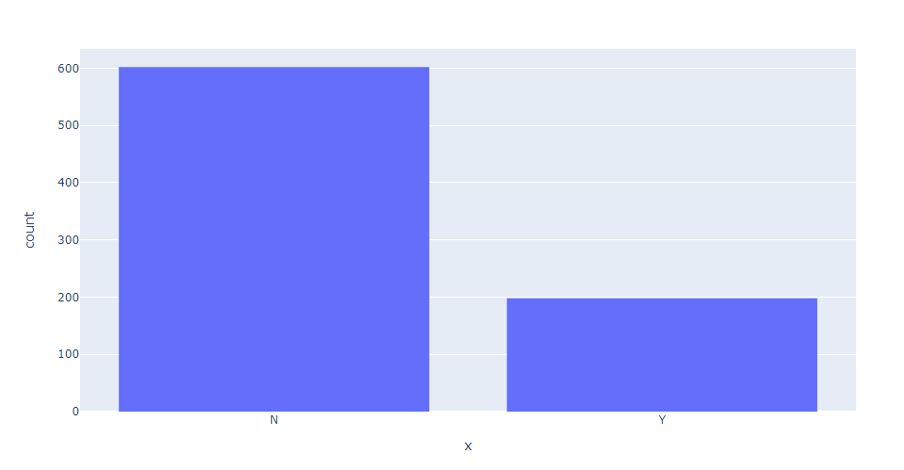
MODELING APPROACH – Data (Kaggle Dataset)
Independent Features
38 total (Mix of categorical/numeric)
Target
Binary
Y – Fraud Reported
N – Fraud Not Reported
TARGET DISTRIBUTION (Training Dataset)

Slide 9
CONTENTS
Exhibit Intro
Modeling Approach
Fraud Model Evaluations
Database Creation and Extraction Techniques
Feature Engineering
Boostrapping
Modeling Techniques (TPOT, Pipeline, Gridsearch, Etc)
Implementation / Business Impact
Future Steps

Slide 10
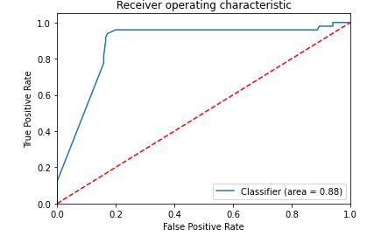
FRAUD MODEL EVALUATIONS – ROC AUC Curve
Impressions
Excellent predictive power
Classifier has the ability to explain ~90% of the correct positive in the first 20%
Stair-stepping expected, but very smooth

Slide 11
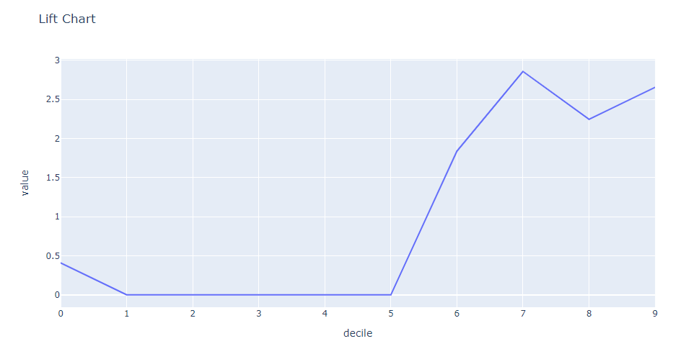
FRAUD MODEL EVALUATIONS – Lift Chart
Impressions
Great separation between the two classes
Cut off was not set to reduce false positives due to reduced performance
Volatility expected in the lower probabilities, but very little

Slide 12
CONTENTS
Exhibit Intro
Modeling Approach
Fraud Model Evaluations
Database Creation and Extraction Techniques
Feature Engineering
Boostrapping
Modeling Techniques (TPOT, Pipeline, Gridsearch, Etc)
Implementation / Business Impact
Future Steps

Slide 13
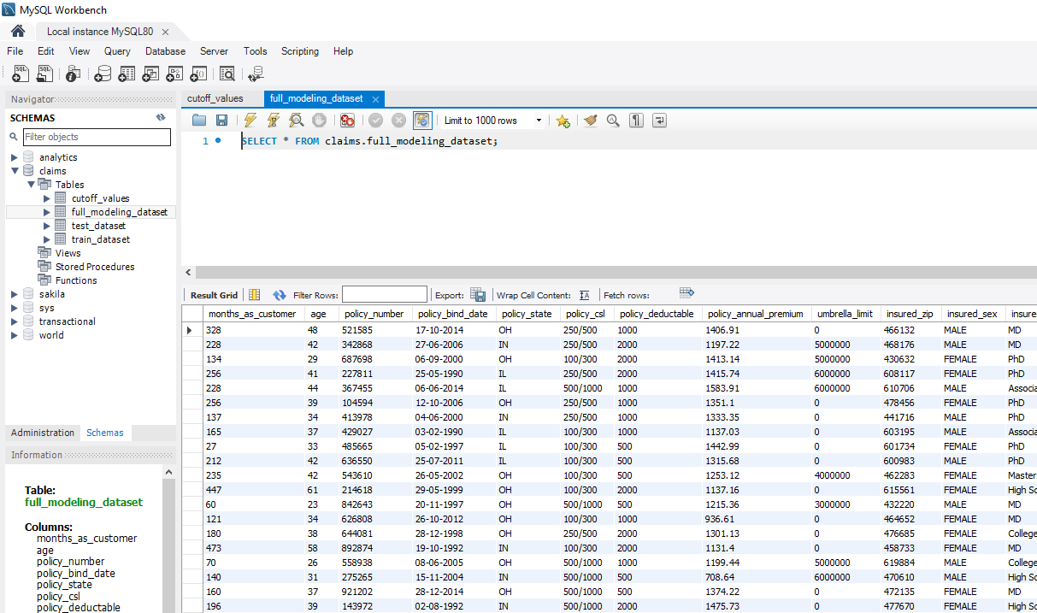
DATABASE CREATION AND EXTRACTION – Server/Database
MySQL Server Local
Local database server created using MySQL Workbench
Claims Database
Store full, train, and test datasets as tables
Store training dataset distribution information (later applied to test)
Rationale
Emulate a production analytics environment
Improve query techniques for analytics ready data
Future Motivation
Implement SQL Replication

Slide 14
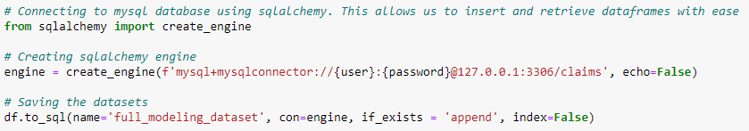
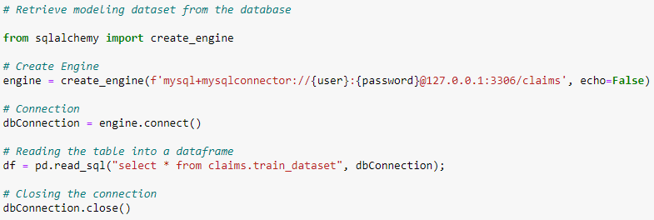
DATABASE CREATION AND EXTRACTION – SQLAlchemy
Create (and fill) a table with 3 lines of code? Straight from a Pandas? DataFrame?
Reduce table create/write
time
Read it back to Pandas just as easily
Reduce scientist extraction/query time

Slide 15
CONTENTS
Exhibit Intro
Modeling Approach
Fraud Model Evaluations
Database Creation and Extraction Techniques
Feature Engineering
Boostrapping
Modeling Techniques (TPOT, Pipeline, Gridsearch, Etc)
Implementation / Business Impact
Future Steps

Slide 16
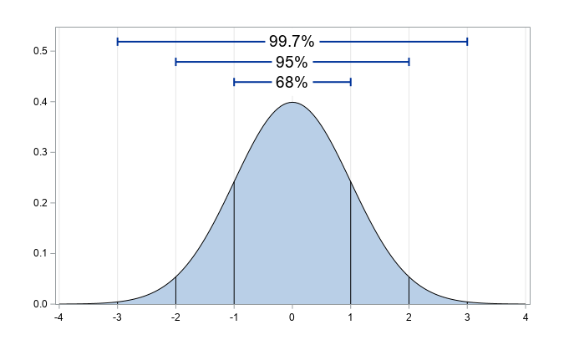
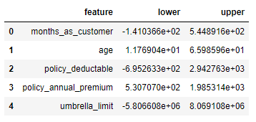
FEATURE ENGINEERING – Outlier Removal & Encoding
Censoring (Capping) Methodology for Numeric Columns
Calculate cutoff value from training dataset mean and standard deviation
Set low/high values at 3 standard deviations from mean
Apply to train and test features
Improves predictive power by removing outliers via distribution distortion
Cutoff Value example
MIN VALUE
MAX VALUE
(Charfaoui, 2018)

Slide 17


FEATURE ENGINEERING – Outlier Removal & Encoding
Target Encoding Methodology for Categorical Columns
Convert categorical to numeric
BEFORE
AFTER

Slide 18

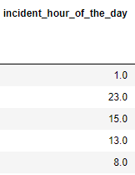
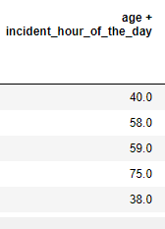
FEATURE ENGINEERING – Feature Tools (Automated Feature Engineering)
Deep Feature Synthesis
Automatically create new features from dataset
Provides more features to try in model with ease
Saves massive amounts of time
Created several new features
Able to work with relational database structure
Assists analysts understand what features are important in a large database
EXAMPLE:

Slide 19
CONTENTS
Exhibit Intro
Modeling Approach
Fraud Model Evaluations
Database Creation and Extraction Techniques
Feature Engineering
Bootstrapping
Modeling Techniques (TPOT, Pipeline, Gridsearch, Etc)
Implementation / Business Impact
Future Steps

Slide 20
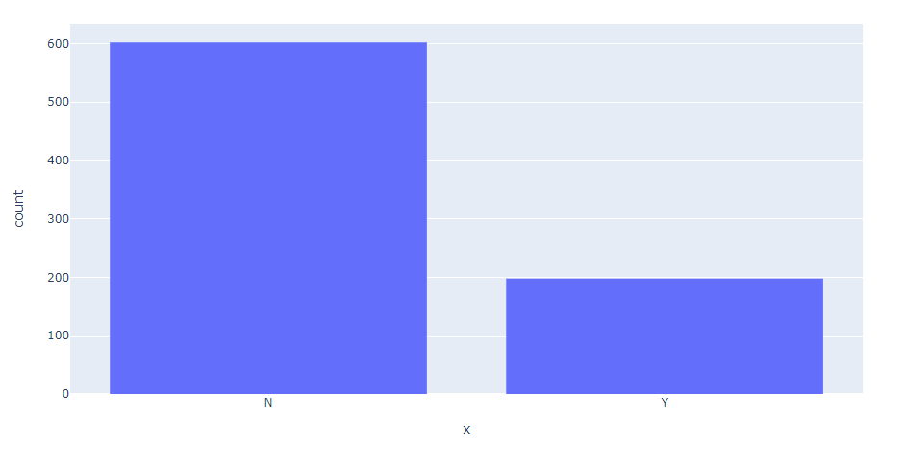
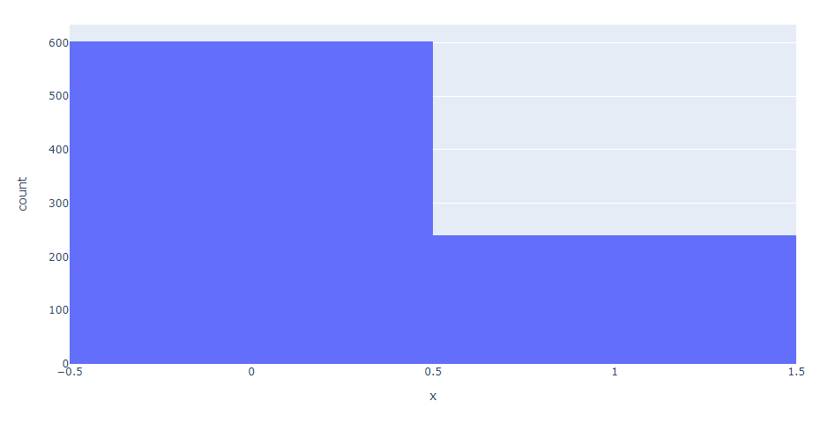
BOOTSTRAPPING– Synthetic Sampling (SVMSMOTE)
Increases data volume
Basically, gives us more data!
Results in a more robust model
With such a small dataset, this technique allows us to better generalize the population
BEFORE
AFTER
Bootstrap

Slide 21
CONTENTS
Exhibit Intro
Modeling Approach
Fraud Model Evaluations
Database Creation and Extraction Techniques
Feature Engineering
Bootstrapping
Modeling Techniques (TPOT, Pipeline, Gridsearch, Etc)
Implementation / Business Impact
Future Steps

Slide 22
MODELING TECHNIQUES – A Shameless Automation Plug: TPOT and DASK
TPOT Automated Pipeline
A genetic programming approach to selecting an optimal solution
Tries many different pipelines
Gives the analyst a good starting point with a difficult problem
Helps, but does not replace the scientist
DASK
Parallel computing for large data
Allows for multiple processes to run at same time for quicker solve time
EXAMPLE

Slide 23
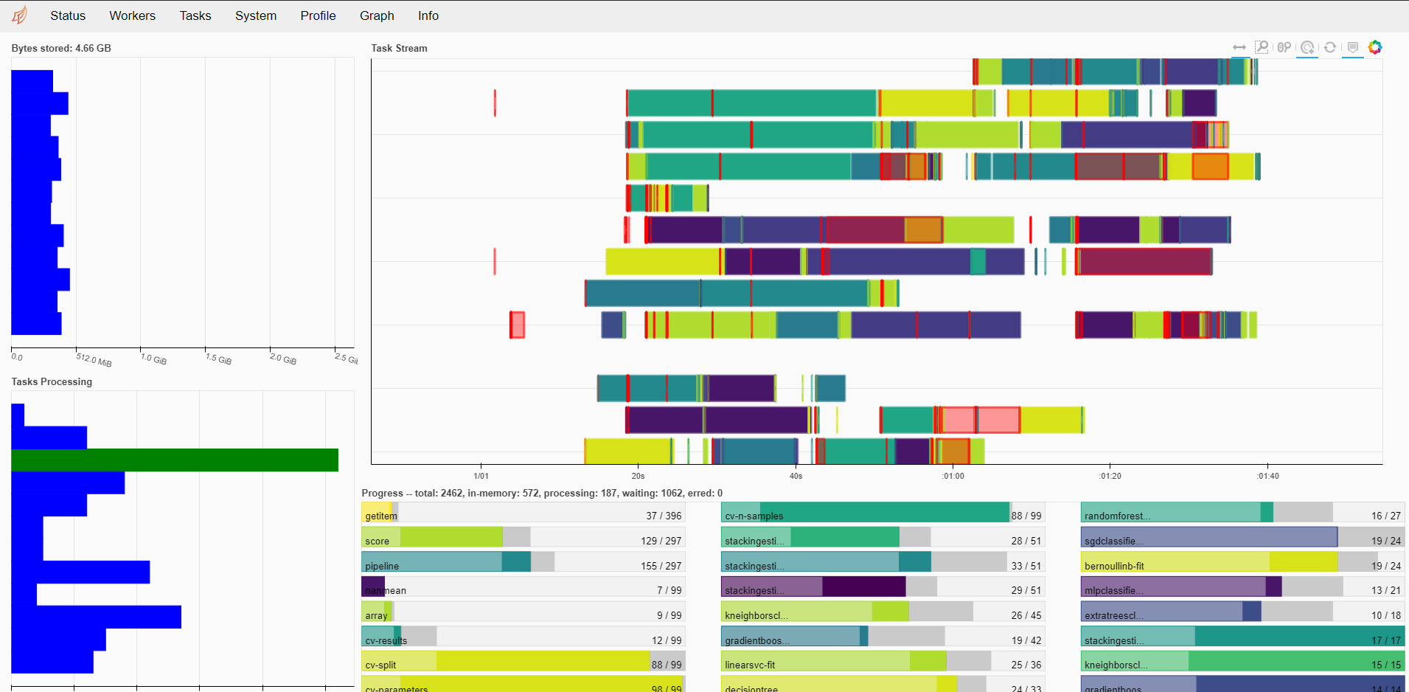
MODELING TECHNIQUES – TPOT and DASK

Slide 24
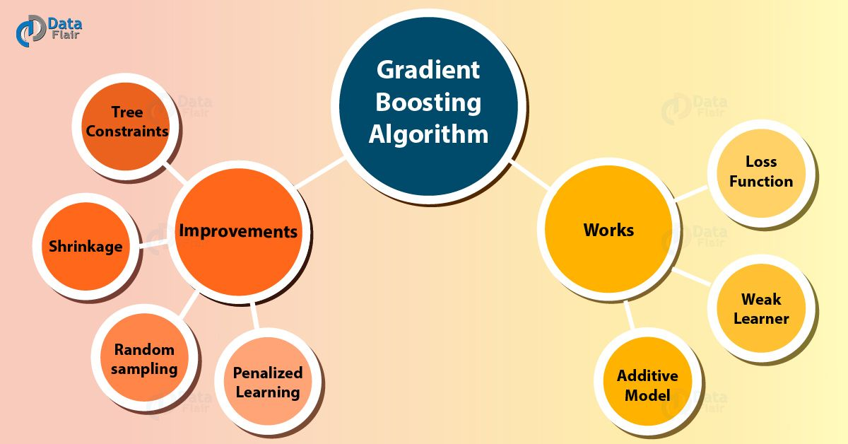
MODELING TECHNIQUES – Final Model and Feature Selection
Gradient Boosting Classifier
Best performer
Allowed for prediction explanation
Ensemble for smoother lift
KBest with Anova feature selection
Reduce non-predictive features
Iteratively try different combinations
Faster predictions!
(Gradient Boosting Algorithm – Working and Improvements, n.d.)

Slide 25
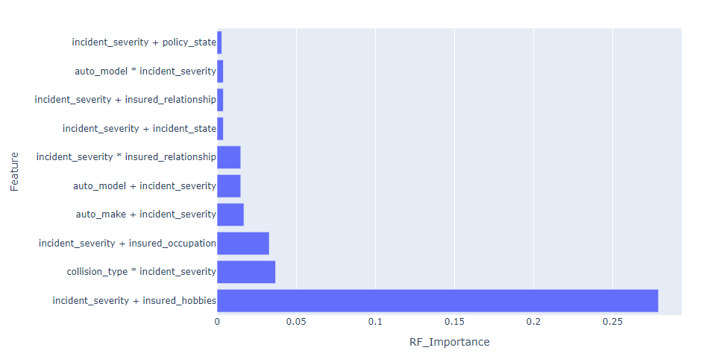
MODELING TECHNIQUES – Important Features
Permutation Importance
Gives better understanding of what is really important
Incident severity: The real hero
Insured hobbies: The real hero?
All important features from FeatureTools
High cardinality may be influencing the importance here

Slide 26
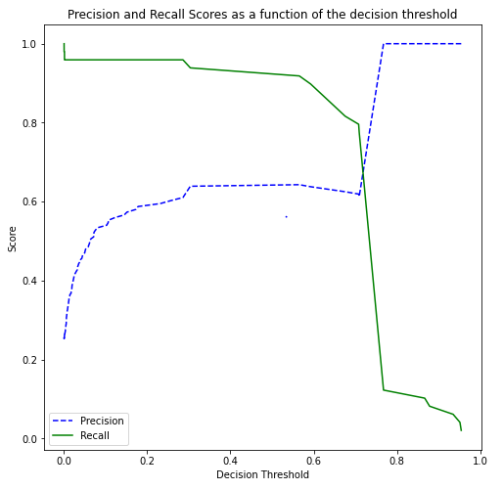

MODELING TECHNIQUES – Precision vs Recall
The chart to the left shows the difference between precision and recall
The chart to the right shows the models tradeoff between these two metrics at various decision thresholds
The threshold was kept at the default of .50. There was little improvement adjusting this value

Slide 27
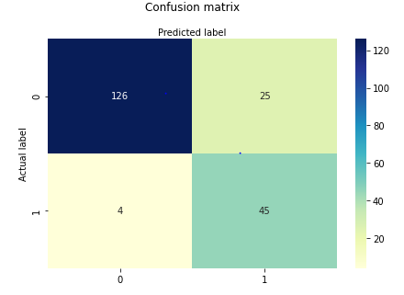
MODELING TECHNIQUES – Confusion Matrix
Impressions
Excellent false negative rates
False positives leave something to be desired
Overall accuracy is excellent
Future Recommendation
Create two separate models
One for explaining predictions
One for detection

Slide 28
CONTENTS
Exhibit Intro
Modeling Approach
Fraud Model Evaluations
Database Creation and Extraction Techniques
Feature Engineering
Bootstrapping
Modeling Techniques (TPOT, Pipeline, Gridsearch, Etc)
Implementation / Business Impact
Future Steps

Slide 29

IMPLEMENTATION / BUSINESS IMPACT – What now?
Implementation Considerations
High false positive rate
May impact customer treatment
Cut off may need tweaking
Beta Testing
Consider a pilot test group
Training
Educate adjusters to maximize model effectiveness
(Weaver, 2019)

Slide 30
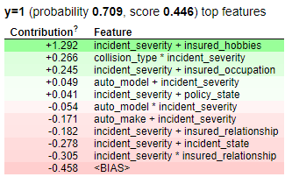
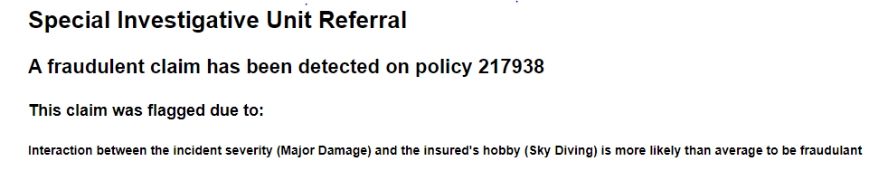
IMPLEMENTATION / BUSINESS IMPACT – Explaining Predictions
Example of Fraudulent Claim
Model has the ability to explain why a claim may be fraudulent
Based on the input values, an adjuster will receive more information relating to the prediction.
Example of possible reason message:
Based on the input, we can see that the top contributing feature in this prediction is the additive interaction between incident_severity and insured_hobbies

Slide 31
CONTENTS
Exhibit Intro
Modeling Approach
Fraud Model Evaluations
Database Creation and Extraction Techniques
Feature Engineering
Bootstrapping
Modeling Techniques (TPOT, Pipeline, Gridsearch, Etc)
Implementation / Business Impact
Future Steps

Slide 32
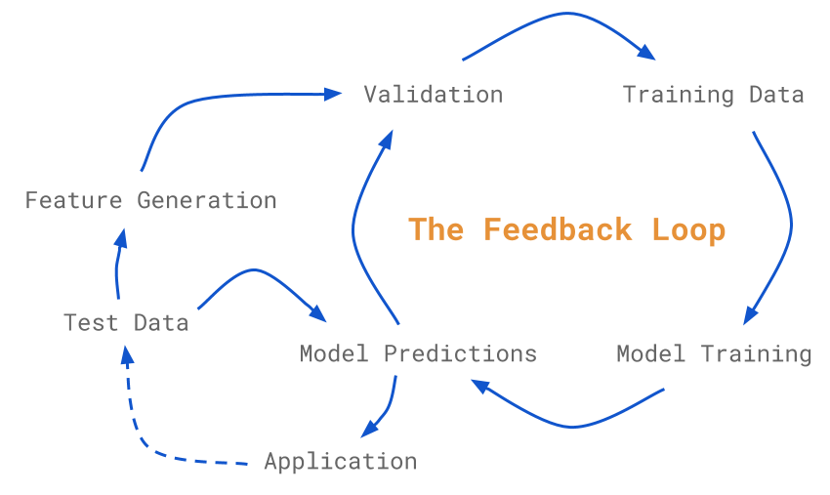
FUTURE STEPS – Feedback
An iterative process
Future products depend on business insight and suggestion
Improved performance overtime
Is it working?
Hands-on experience can be the best guidance
More data is better
Understanding how this impacts adjusters creates actionable insight data. What action did they take?
(Morrison, 2019)

Slide 33
FUTURE STEPS – Two Models
Split the product into two separate models
One model focused on increasing predictive power
One model to focus on explaining the prediction
The product does both fairly well, but there is always room for improvement
Feedback loop may provide more data for the explanation model
Improve insight into fraudulent claims
Provide actionable insight based on previous predictions
Explore other models less ideal for score reasons, more ideal for predictability
Black box models may improve results

Slide 34
References
Charfaoui, Y. (2018, June). Hands-on with Feature Engineering Techniques: Handling Outliers. Retrieved from HeartBeat: https://heartbeat.fritz.ai/hands-on-with-feature-engineering-techniques-dealing-with-outliers-fcc9f57cb63b
Gradient Boosting Algorithm – Working and Improvements. (n.d.). Retrieved from Data Flair: https://data-flair.training/blogs/gradient-boosting-algorithm/
Morrison, J. (2019, December 9). Designing Effective Supervised Machine Learning Systems. Retrieved from Medium: https://medium.com/@joemorrison/designing-effective-supervised-machine-learning-systems-91eb7b466129
Precision and Recall. (2020, October 9). Retrieved from Wikipedia: https://en.wikipedia.org/wiki/Precision_and_recall
Weaver, D. (2019, May 15). Three Tips for Deferring Insurance Fraud. Retrieved from Inform: https://www.inform-software.com/blog/post/3-tips-for-deterring-insurance-fraud

